Slide 1
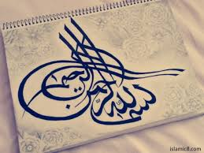

Slide 2

English Composition & Comprehension

Slide 3

CONTENT
Introduction
Classification based on Time Frame
Classification based on Aspect
Block diagram of Tenses
List of Rules
Present Tense
Past Tense
Future Tense
List of Examples

Slide 4
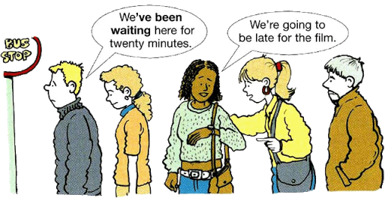
INTRODUCTION
The word Tense is derived from Latin word “tempus” which means time. A verb indicates the time of an action, event or condition by changing its form.

Slide 5
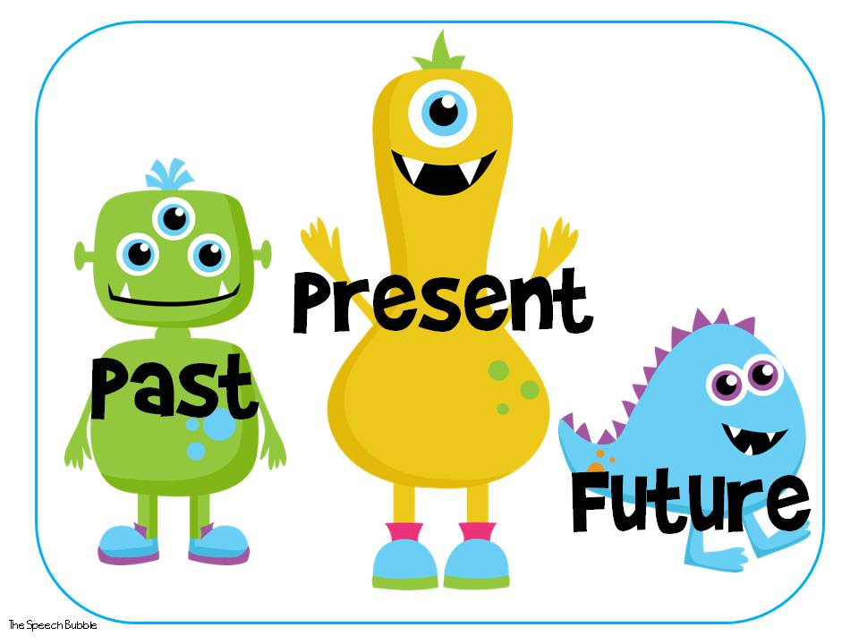
Based on Time frame
The verb tenses may be categorized according to the time frame.

Slide 6
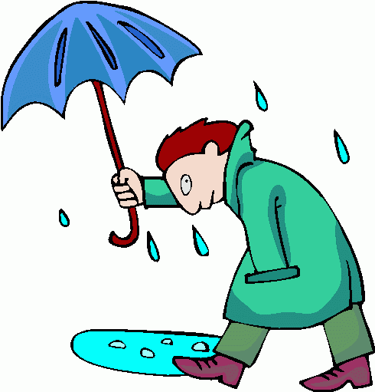
Present Tense
Present tense expresses an unchanging, repeated, or reoccurring action or situation that exists only now. It can also represent a widespread truth.
It is raining again.

Slide 7
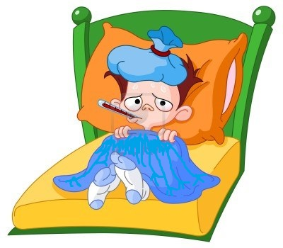
Past Tense
Past tense expresses an action or situation that was started and finished in the past.
He was ill last week.

Slide 8
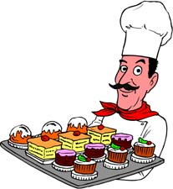
Future Tense
Future tense expresses an action or situation that will occur in the future.
You will be a good chef.

Slide 9
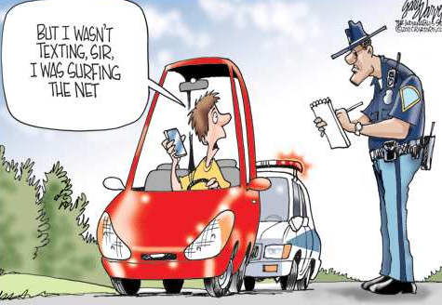
Based on Aspect
Verb tenses may also be categorize according to aspect. Aspect refers to the nature of the action described by the verb. There are four aspects:
Indefinite or Simple
Continuous or Progressive
Perfect or Complete
Perfect Continuous

Slide 10
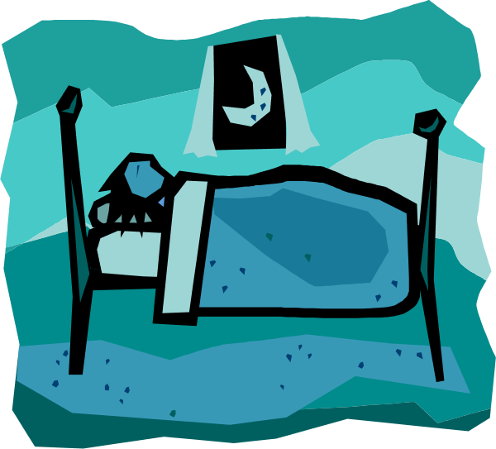
Indefinite Tense
The three indefinite tenses, or simple tenses, describe an action but do not state whether the action is finished.
He sleeps.
I slept.
You will sleep.

Slide 11
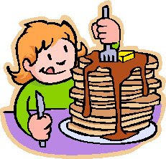
Continuous Tense
The three continuous tenses, incomplete tenses, or progressive tenses, describe an unfinished action.
She is eating.
You was eating too much.
I will be eating a lot.

Slide 12

Perfect Tense
The three complete tenses, or perfect tenses, describe a finished action.
She has done her work.
You had done it.
I will have finished the book.

Slide 13

Perfect Continuous Tense
To combine the complete tenses and the incomplete tenses, to describe an action which was in progress and then finished.
She has been trying to contact me.
You had been waiting all day.
I will have been teaching for the last thirty years.

Slide 14
There are twelve possible verb tenses.
Verb Tenses
Present
Past
Future
Present Indefinite
Present Continuous
Present Perfect
Present Perfect Cont.
Past Indefinite
Past Continuous
Past Perfect
Past Perfect Cont.
Future Indefinite
Future Continuous
Future Perfect
Future Perfect Cont.
CONTENTS

Slide 15
Here is a list of rules of these tenses
 | Simple Forms | Progressive Forms | Perfect Forms | Perfect Progressive Forms
Present | Ist form + s / es | am/is/are + Ist form + ing | have/has + IIIrd form | have/has been + Ist form + ing
Past | IInd form | was/were + Ist form + ing | had + IIIrd form | had been + Ist form + ing
Future | will/shall + Ist form | will be + Ist form + ing | will have + IIIrd form | will have been + Ist form + ing
CONTENTS

Slide 16

Present Tense
Present
Present Indefinite Tense
Present Continuous Tense
Present Perfect Tense
Present Perfect Cont.Tense

Slide 17

Present Indefinite Tense
The simple present is used to describe an action, an event, or condition that is occurring in the present, at the moment of speaking or writing.
For Example—
I play.
He / She plays.

Slide 18

Present Continuous Tense
The present continuous emphasizes the continuing nature of an act, event, or condition.
For Example—
I am eating.
He / She is eating.
They are eating.

Slide 19

Present Perfect Tense
The present perfect tense is used to describe action that began in the past and continues into the present or has just been completed.
For Example—
I have learnt.
He / She has learnt.

Slide 20

Present Perfect Cont.Tense
The present perfect continuous is used to describe an action, event, or condition that has begun in the past and continues into the present.
For Example—
I / You have been sleeping.
He / She has been sleeping.
CONTENTS

Slide 21

Past Tense
Past
Past Indefinite Tense
Past Continuous Tense
Past Perfect Tense
Past Perfect Cont.Tense

Slide 22
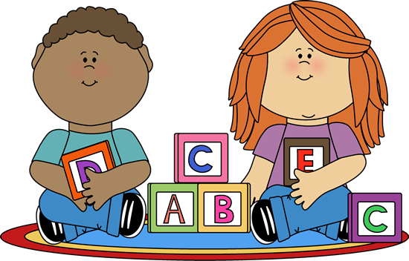
Past Indefinite Tense
The simple past is used to describe an action, an event, or condition that occurred in the past.
For Example—
I played.
He / She played.

Slide 23

Past Continuous Tense
The past continuous tense is used to described actions ongoing in the past.
For Example—
I was playing.
He / She was playing.
You were playing.

Slide 24
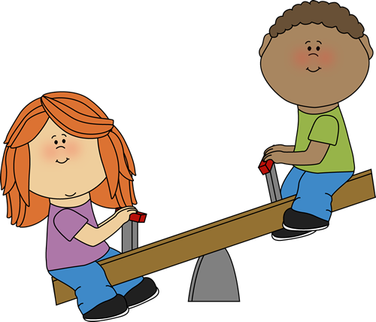
Past Perfect Tense
The past perfect tense is used to refer to actions that took place and were completed in the past.
For Example—
I had played.
He / She had played.

Slide 25
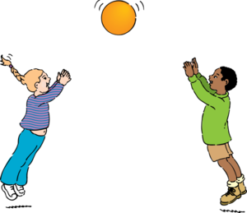
Past Perfect Cont.Tense
The past perfect continuous is used to indicate that a continuing action in the past began before another past action began or interrupted the first action.
For Example—
I had been playing.
He / She had been playing.
CONTENTS

Slide 26
Future Tense
Future
Future Indefinite Tense
Future Continuous Tense
Future Perfect Tense
Future Perfect Cont.Tense

Slide 27
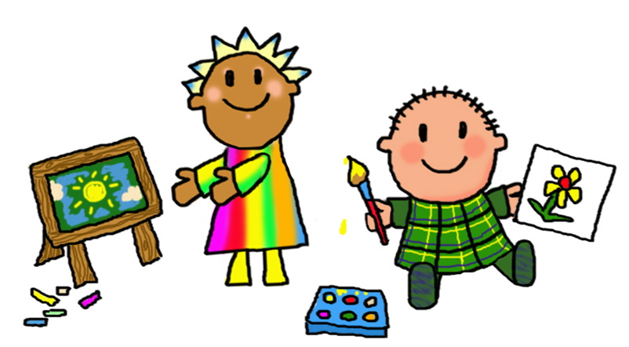
Future Indefinite Tense
The simple future is used to refer to actions that will take place after the act of speaking or writing.
For Example—
I shall play.
He / She will play.

Slide 28
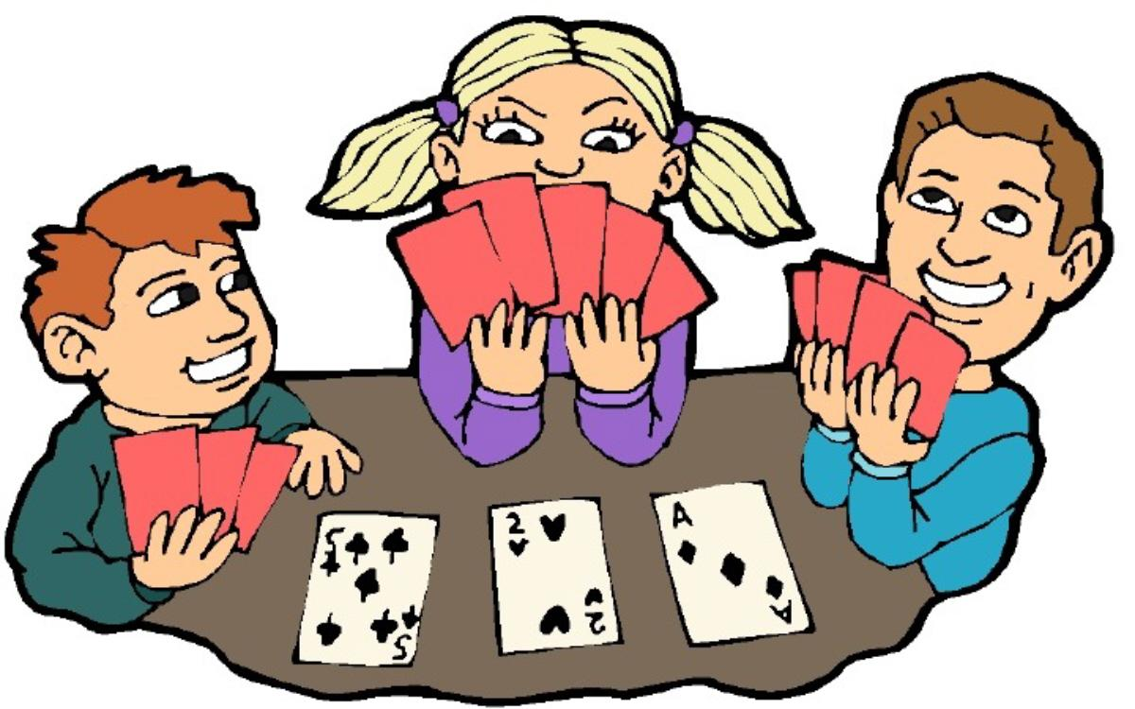
Future Continuous Tense
The future continuous tense is used to describe actions ongoing in the future. The future progressive is used to refer to continuing action that will occur in the future.
For Example—
I shall be playing.
He / She will be playing.

Slide 29
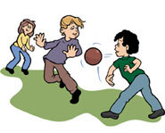
Future Perfect Tense
The future perfect is used to refer to an action that will be completed sometime in the future before another action takes place.
For Example—
I shall have played.
He / She will have played.

Slide 30

Future Perfect Continuous Tense
The future perfect continuous tense is used to indicate a continuing action that will be completed at some specified time in the future.
For Example—
I shall have been playing.
He / She will have been playing.
CONTENTS

Slide 31
Here is a list of examples of these tenses and their definitions
 | Simple Forms | Progressive Forms | Perfect Forms | Perfect Progressive Forms
Present | I play | I am playing | I have played | I have been playing
Past | I played | I was playing | I had played | I had been playing
Future | I shall play | I shall be playing | I shall have played | I shall have been playing

Slide 32
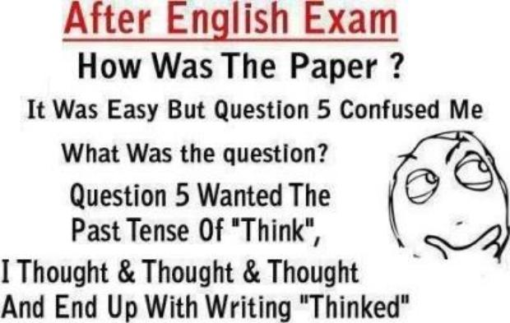
Joke Of The Day

Slide 33


